Slide 1

Cybersecurity
Eryk.T, Rens.S, Damian.P,

Slide 2
Content page
Hackers
Use in companies
How to protect your own data
Future of securatie

Slide 3
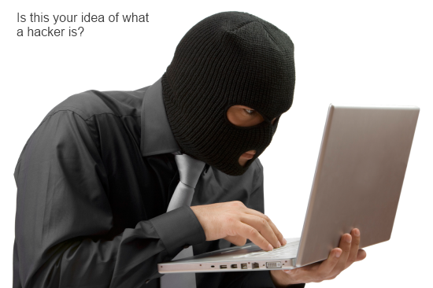
Hackers
- What is a hacker?
- How do u hack?
- ethicality?

Slide 4
Use in companies
Cyber attack
Data stealing
Prevention

Slide 5
How to protect your own data
Anti virus
links
password

Slide 6
Future of securatie
Phising
Online
Age verification

